Slide 1
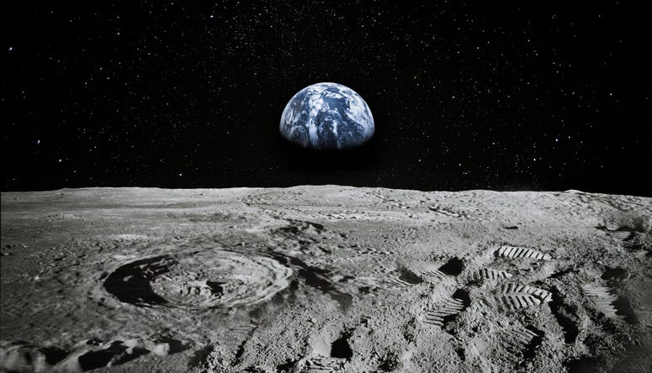
LUNAR LANDING PAYLOAD CRANE
Alanna Black | Jayson Dickinson | Christina Morrow | Ryker Mullinix
TEAM 517

Slide 2
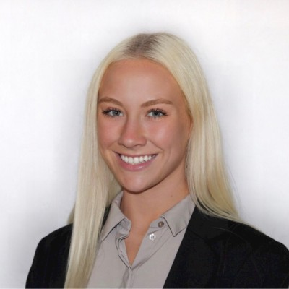


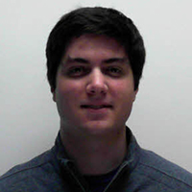
Meet Team 517
Alanna Black
Jayson Dickinson
Christina Morrow
Ryker Mullinix
Robotics &
Controls Engineer
Project Manager &
Fluid Dynamics Engineer
Design & Test
Engineer
Materials Engineer
Christina Morrow

Slide 3

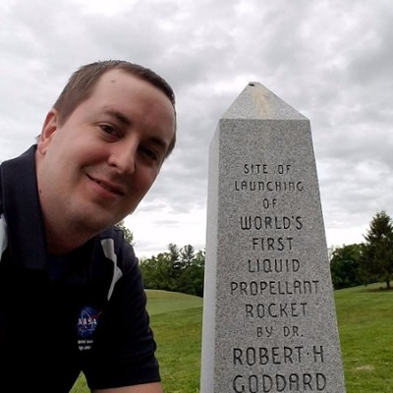
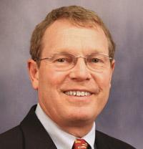
Sponsor & Advisor
Rachel McCauley
Justin Rowe
Dr. Eric Hellstrom
NASA Marshall Space
Flight Center
NASA Marshall Space
Flight Center
FAMU-FSU
College of Engineering
Christina Morrow

Slide 4




Project Objective
The objective of this project is to offload the LSMS (Lightweight Surface Manipulation System) from the CLPS (Commercial Lunar Payload Services) lander onto a platform.
4m
Christina Morrow

Slide 5




Project Background
NASA Plans for
Lunar Base
NASA Developed Payload Crane
v
v
Artemis Mission
Announced
Design Payload Crane Off-loader
Christina Morrow

Slide 6

Motivation
Christina Morrow

Slide 7
Motivation
Christina Morrow

Slide 8
A
R
R
O
W
AUTOMATED AND RANGED RELOCATION OF THE LSMS FOR WIDER APPLICATION
Christina Morrow

Slide 9




Customer Needs
How much does the LSMS weigh?
Is there a time constraint for transporting the LSMS?
What is the expected level of autonomy?
What scale should be used?
The ARROW will lift up to 300 lbs.
There is no time constraint for transport of the LSMS.
Automation for offloading will be part of the landing sequence.
The ARROW will be scalable to mate with the LSMS.
Christina Morrow

Slide 10




Assumptions
THE ARROW HAS ACCESS TO POWER VIA THE CLPS LANDER
LSMS WILL SEND READY SIGNAL TO ARROW
REUSABILITY IS NOT A CONCERN
LSMS CAN DOCK TO LUNAR PLATFORM
Ryker Mullinix

Slide 11


Key Goals
AUTONOMY
OFFLOAD LSMS
SCALABILITY
Ryker Mullinix

Slide 12




Functional Decomposition
MOTION
COMMUNICATION
POWER
SUPPORT
Ryker Mullinix

Slide 13
Functional Decomposition
MOTION
RELOCATE THE LSMS
MOVE ABOUT AXES
MOTION
Ryker Mullinix

Slide 14
Functional Decomposition
SUPPORT
STABILIZE LSMS
DECREASE POSITION ERROR
POSITION LSMS
SECURE LSMS
SUPPORT SCALE
RELEASE LSMS
SCALE FOR VARIABLE LSMS SIZE
SUPPORT
Ryker Mullinix

Slide 15
Functional Decomposition
POWER
RECEIVE POWER
CONVERT POWER TO TORQUE
POWER
Ryker Mullinix

Slide 16
Functional Decomposition
COMMUNICATION
SENSE SIGNAL
RECEIVE SIGNAL
TRANSMIT SIGNAL
TRANSDUCE SIGNAL
PROCESS SIGNAL
COMMUNICATION
Ryker Mullinix

Slide 17






Future Work
TARGETS &
METRICS
CONCEPT
GENERATION
CONCEPT
EVALUATION
CONCEPT
SELECTION
Ryker Mullinix

Slide 18





LUNAR LANDING PAYLOAD CRANE
Alanna Black | Jayson Dickinson | Christina Morrow | Ryker Mullinix
TEAM 517

Slide 19

Background Info - Artemis
Artemis Mission Milestones:
Scheduled to Launch in 2023
Sending the next man and first woman to the moon
Major goal is to set up a lunar base
Photos from nasa.gov

Slide 20
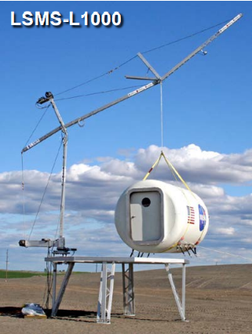
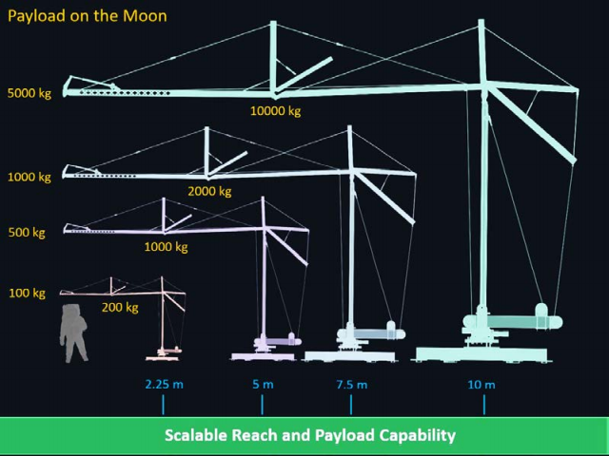
Background Info - LSMS
Versatile and Multi-Functional:
Precision Payload Lifting / Unloading
Large-Scale 3-D Printing
Assembly, and Regolith Excavation and Handling
Astronaut Elevator
Deploying Structures + Science
Connections, E-Beam Welding
NASA LSMS Crane
Info and Photos from Presentation Given by Tom Jones

Slide 21
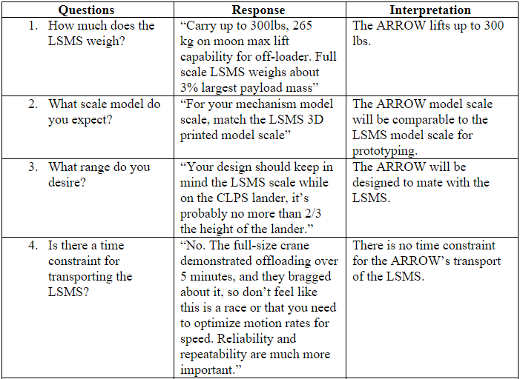
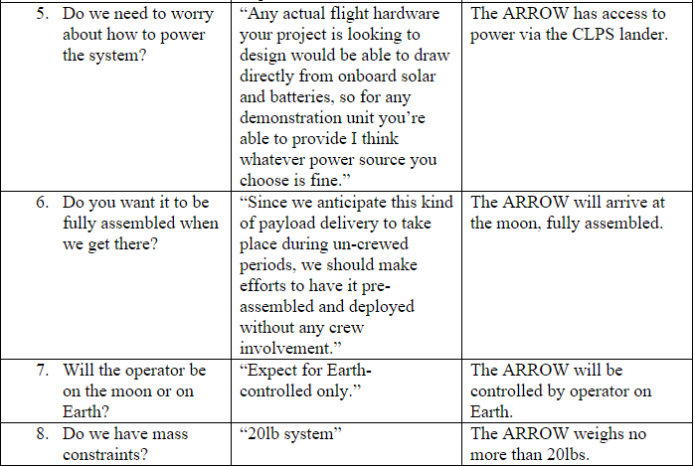
Customer Needs (new)

Slide 22
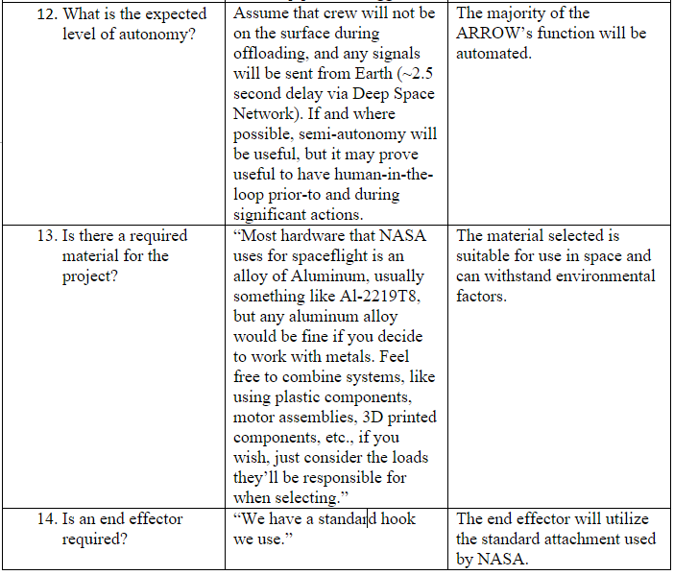
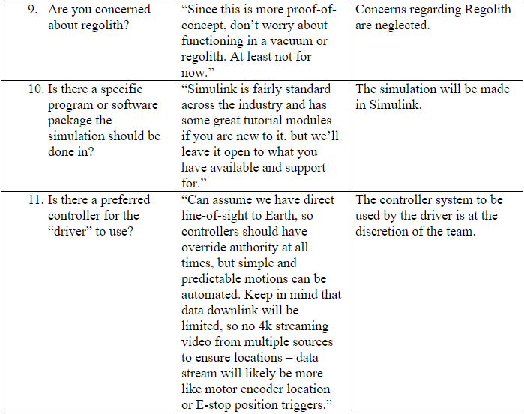
Customer Needs (new)

Slide 23
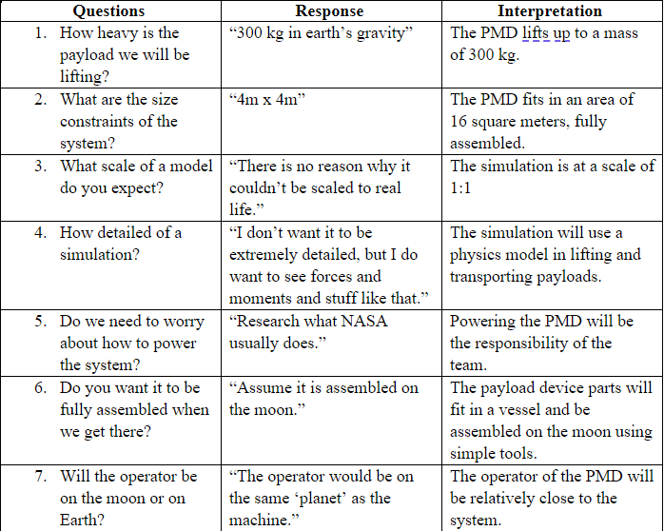
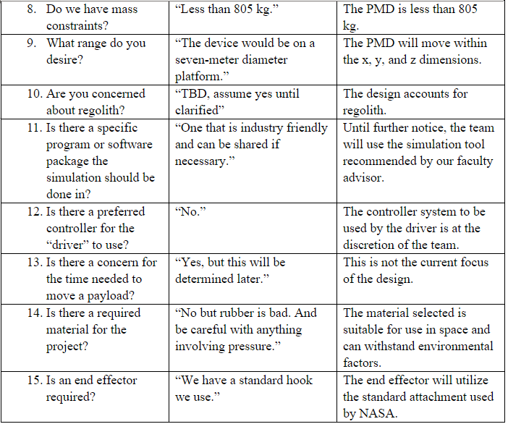
Customer Needs (old)

Slide 24
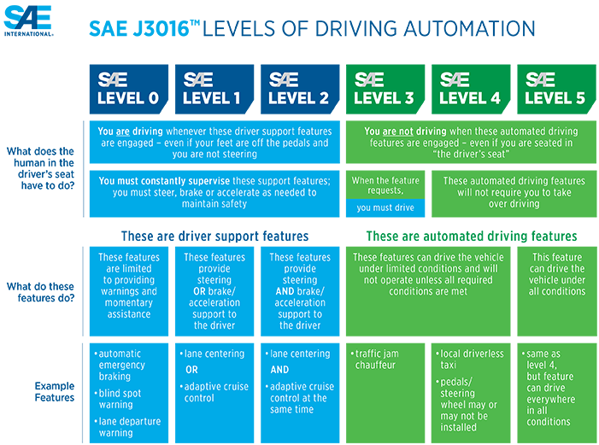

Key Goals – SAE Standards

Slide 25
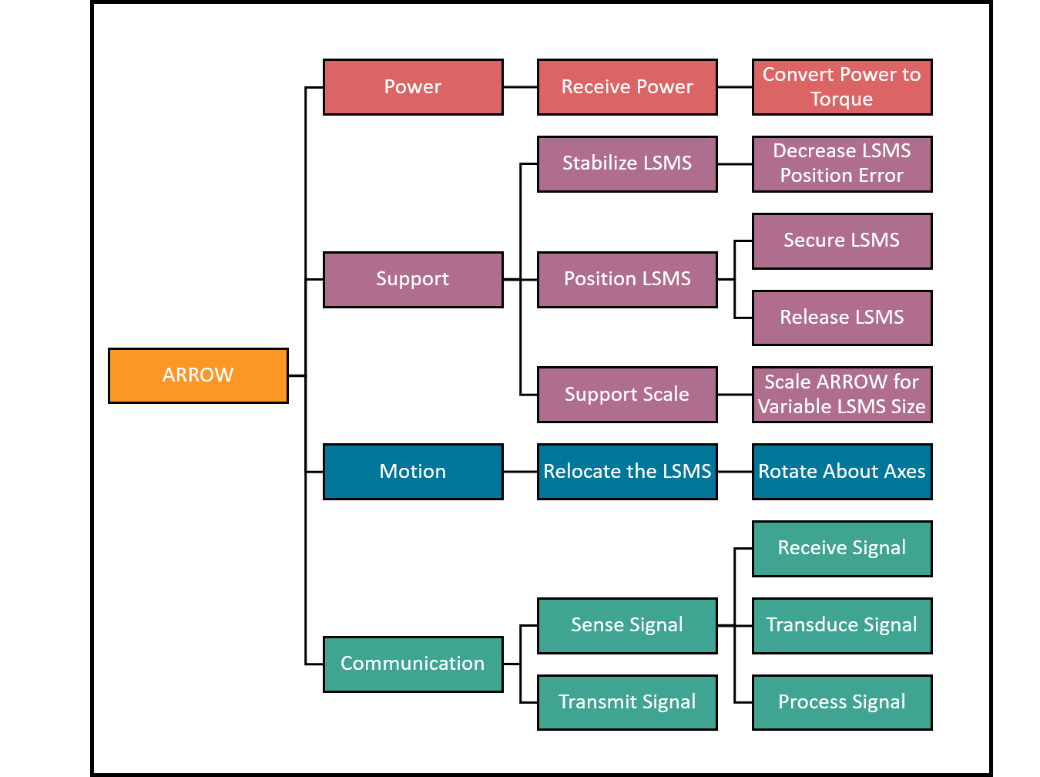
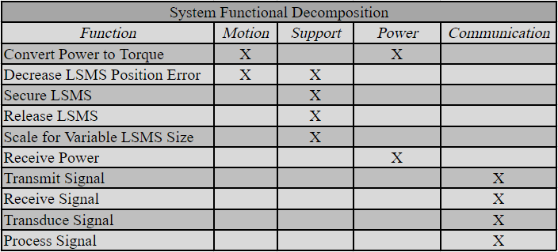
Functional Decomposition (new)
Cross Reference Table
Hierarchy Flow Chart

Slide 26
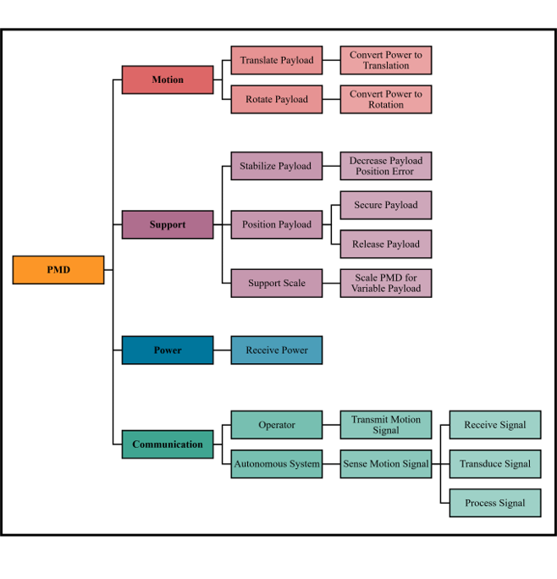
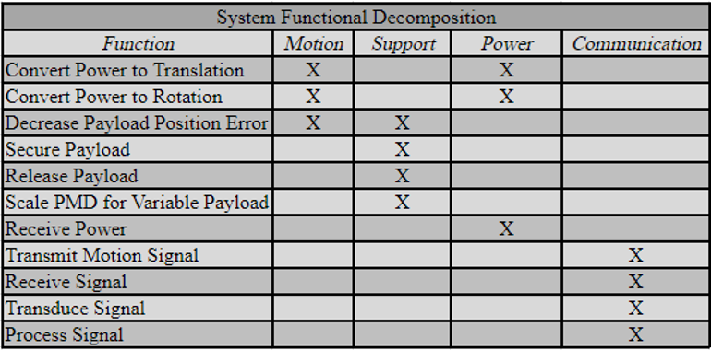
Functional Decomposition (old)
Cross Reference Table
Hierarchy Flow Chart

Slide 27

Color Palette

Slide 28


Team 517 Icons
Lunar Base Module
ARROW
Rotate about Z-axis
Rotate about Y-axis
CLPS Lander
LSMS
Mobility Chassis
4m
Ryker

